Slide 1

Welcome!

Slide 2
Disability Pride and Culture: The Independent Living Philosophy and History
Presentation by Derek Zarda, Assistive Technology Educator,
Independent Living Resource Center San Francisco
Stacy Milbern, Program Manager
Center for Independent Living

Slide 3
Today’s Presenters
Stacey Milbern is the Program Manager for Center for Independent Living in Berkeley. She started out as a youth organizer who had been working in the youth arm of the Disability Rights Movement since high school. She is involved with youth activism and women of color media making. She is also a regular blogger on cripchick.
Derek Zarda is the Assitive Technology Educator for Independent Living Resource Center San Francisco. He started advocating as a youth with a disability in high school, and co-founding the first disability advocacy student group in college. He enjoys teaching independent living skills to youth in local high schools and serving on the Mayor’s Disability Council.

Slide 4
Webinar Overview
Explore the history of the Independent Living Movement
Learn about the role of the Independent Living Center in your community.
Discuss what your local Independent Living Center can do for you.
Learn how you can get involved in your Independent Living Center.

Slide 5
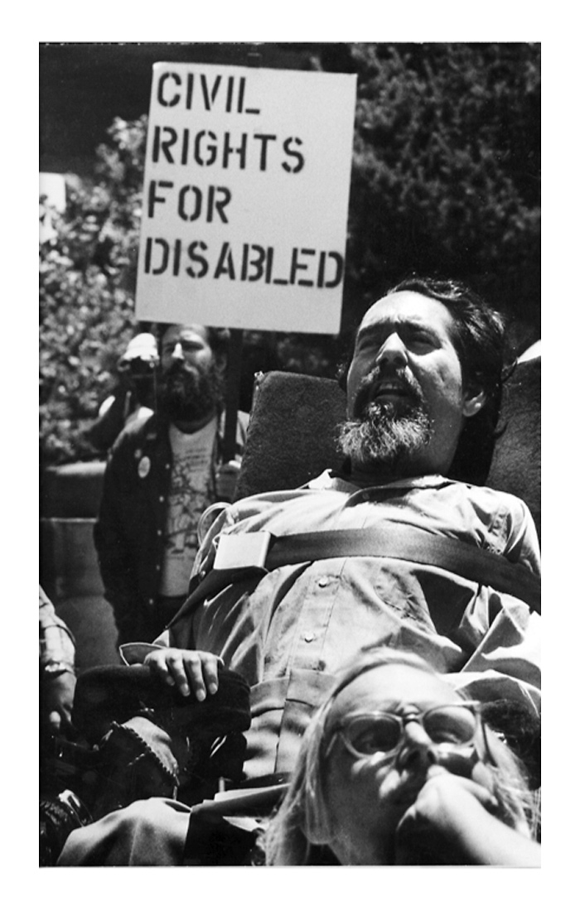
Ed Roberts Day
Known as the Father of the Independent Living Movement for people with disabilities.
In 2010, legislature was passed in California to mark Jan. 23 as a celebration of Ed Roberts.

Slide 6
Historical Context
People with disabilities throughout history have been defined as objects of shame, fear, pity or ridicule.
Americans with disabilities have been kept in back rooms, or even incarcerated in state institutions and nursing homes.
Community based living seems obvious to some, but is still very controversial.

Slide 7
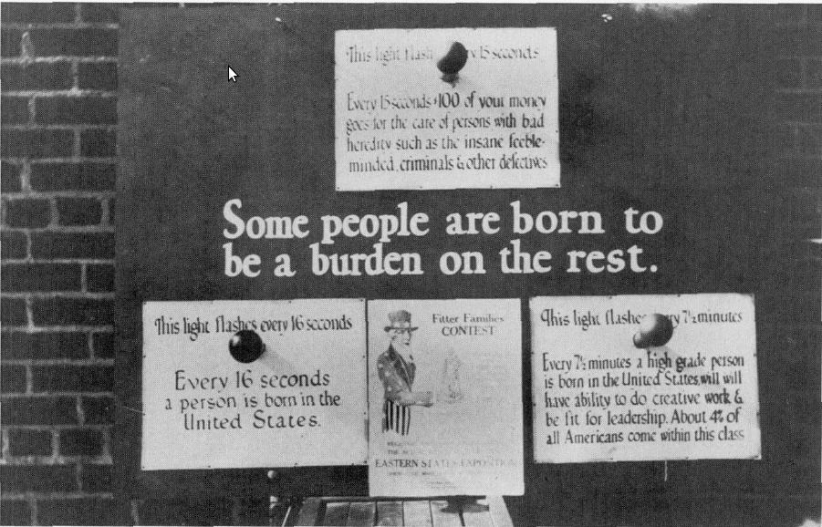
Historical Context
As recently as 1979, it was legal for some state governments to sterilize disabled people against their will.
Other laws prohibit(ed) people with certain disabilities from marrying, or even from appearing in public.

Slide 8
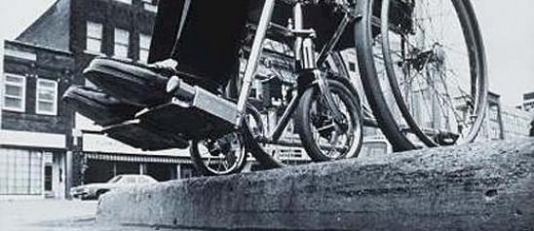
What does the IL Philosophy mean?
Everyone deserves the right to have self determination and exercise choice.
Social Model
There is value in peer to peer interactions. We are not social workers!
At the same time, people with disabilities can be professionals.

Slide 9
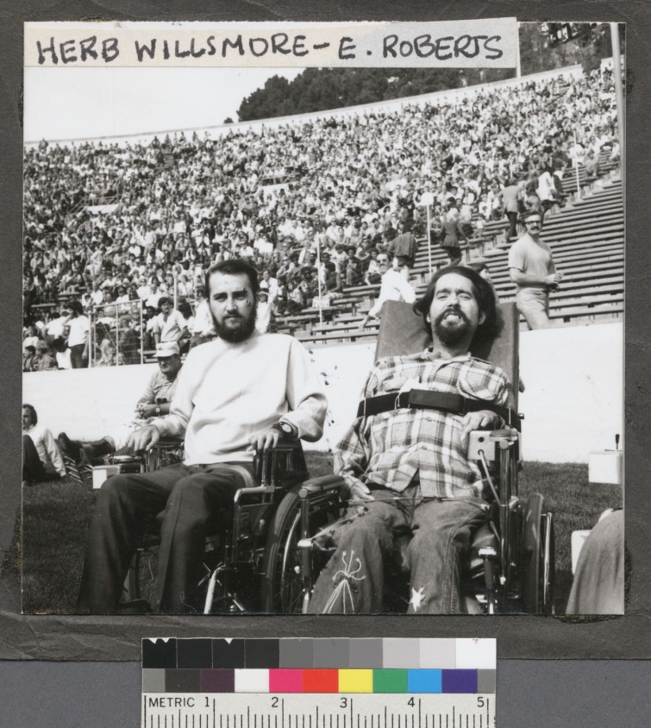
Independent Living Movement
Begun in the early 1960s by UC Berkeley students
CIL was the first organization where people with disabilities could advocate for themselves and find ways to live independently in the community.

Slide 10
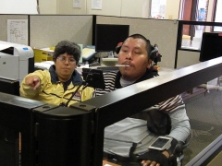
What Makes ILCs Stand Out
Operates from peer-model, not social workers
ILC staff are typically people with disabilities who ensure consumers take lead in identifying their goals.

Slide 11
What Makes an ILC an ILC?
The Four Core services
Information and Referral
Peer support
Independent Living Skills training
Systems Advocacy
Additional core services
Housing Referral (CA only)
Personal Care Attendant Referral (CA only)

Slide 12
Requirements to be an ILC
the Board of Directors must be 51% persons with significant disabilities,
the majority of decision makers in the organization must be persons with disabilities,
consumer control philosophy must be operationalized in all facets,
specific core services must be provided.

Slide 13

What Can an ILC do for you?
Call them and ask
Provide a positive environment for people of all disabilities
Offer guidance and resources for reaching your goals.
Additional services

Slide 14

What Can You Do For An ILC?
Join youth program and take leadership role.
Start youth program.
Intern about something your passionate about or want to develop a skill.
Blog for the ILC!

Slide 15
What Can You Do For An ILC? (cont.)
Meet with leadership about how they can support youth leadership.
Help do outreach to you.
Invite your friends to get active.
Attend ILC events, like fundraisers.

Slide 16
Q & A Time!

Slide 17
The End. Thanks for Participating!

